Slide 1
Issues in Turkish Derivational Morphology
Utku can Kunter
Adv: Cem bozşahin

Slide 2
Agenda
Motivation
Problem Definition
State of the Art
Shape of the Problem
Preliminary Work

Slide 3
Motivation
DM Understudied
Priority on syntax
Second step IM
DM More Complex
More variety
Semantic content
Turkish DM
Quite productive affixes
CCG
Not too loose
Not too restrictive
Rich DM

Slide 4
Problem Definition
Syntax vs Morphology
Inflection vs Derivation
Subsets of Derivation
Generative vs Constraint-Based Grammars

Slide 5
Problem Definition
Syntax vs Morphology
Inflection vs Derivation vs Construction
Subsets of Derivation
Generative vs Constraint-Based Grammars

Slide 6
Problem Definition
Morphology distributes itself
A theory of morphology still necessary
Three approaches
Item and Arrangement
Item and Process
Word and Paradigm
Syntax vs Morphology

Slide 7
Problem Definition
No clear boundary
Productiveness
Change in Grammatical Role
Closeness to the stem
Being required by syntax
Phrasal behavior
...
Computational analyses reveal important clues
Inflection vs Derivation vs Construction

Slide 8
Problem Definition
Morphology
Derivational Morphology
Turkish DM
Turkish DM with Turkish Origins
More productive
Understudied
Rich and diversified
Subsets of Derivation

Slide 9
Problem Definition
Chomskian Grammars
Autonomy of syntax
CCG
Syntax and semantics simultaneously «projected from the lexicon»
DM more involved with semantics
Chomskian Grammar vs CCG

Slide 10
State of the Art
Morphology at Large
Some Particular Aspects of Morphology
Representing Major Grammatical Categories
Turkish Morphology
CCG

Slide 11
State of the Art
Lexical-Conceptual Structure
Thematic Structure
Argument Structure
Event Structure
Morphology at Large
Grimshaw (1990)

Slide 12
State of the Art
Lexical-Conceptual Structure
Thematic Structure
Argument Structure
Event Structure
Syntax
Morphology
Morphology at Large
Sezer (1991)

Slide 13

State of the Art
Inflection
c-Selection
Derivation
s-Selection
Morphology at Large

Slide 14
State of the Art
Aronoff (1994)
Separation Hypothesis
Aronoff and Fudeman (2005)
Carstairs-McCarthy (2010)
Lieber (1992)
Morphology at Large

Slide 15
State of the Art
Baker (1988)
UTAH
Moens and Steedman (1988)
Turkish Emphatic Reduplication
Wedel (1999)
Kılıç and Bozşahin (2013)
A kind of construction?
Some Particular Aspects of Morphology

Slide 16
State of the Art
NPs
Grimshaw (1990)
Verbs
Van-Valin (2006)
Adjectives
Paoli (1999)
Paradis (2001)
Kennedy and McNally (2005)
Kennedy (2007)
Adverbs
Representing Major Grammatical Categories

Slide 17
State of the Art
An outline of Turkish morphology
Oflazer et al. (1995)
Bozşahin (2018)
Comprehensive sources
Erguvanlı-Taylan (2001)
Göksel and Kerslake (2005)
Turkish Morphology

Slide 18
State of the Art
Bozşahin (2002)
Steedman and Baldridge (2011)
Bozşahin (2017)
CCGlab
CCG

Slide 19
State of the Art
Steedman and Bozsahin (n.d.) (PFTL)
Chapter 4: The Categorial Lexicon
Single vs double slashes
Chapter 16: Turkish «Complex» Morphology and Transparency of Derivation
Relativization
Coordination
Unbounded constructions
CCG

Slide 20
Shape of the Problem
Major Grammatical Categories
An Inventory of Turkish Affixes
A Glance at Inflectional Processes

Slide 21
Shape of the Problem
Nouns
Verbs
Adjectives
Adverbs
Major Grammatical Categories

Slide 22
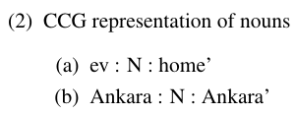
Major Grammatical Categories
Nouns
Verbs
Adjectives
Adverbs

Slide 23
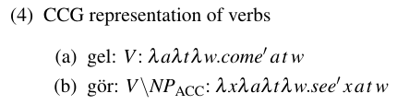
Major Grammatical Categories
Nouns
Verbs
Adjectives
Adverbs

Slide 24
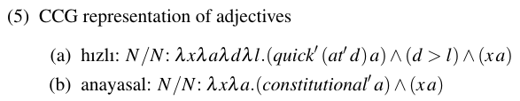
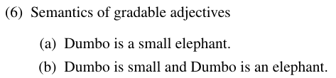
Major Grammatical Categories
Nouns
Verbs
Adjectives
Adverbs

Slide 25
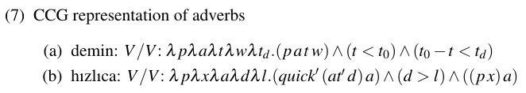
Major Grammatical Categories
Nouns
Verbs
Adjectives
Adverbs

Slide 26
Shape of the Problem
Oflazer et al. (1995)
Bozşahin (2018)
Coding scheme
NNI_PLU
VVI_REFX
VJD_AL
AAD_CEK
...
An Inventory of Turkish Affixes

Slide 27
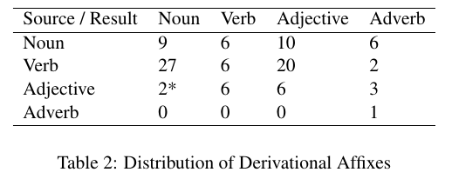
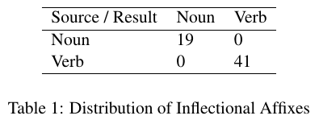
An Inventory of Turkish Affixes

Slide 28
Shape of the Problem
Plural
Case
Relative
T/A/M
Agreement
Voice
Inflectional Processes

Slide 29

Inflectional Processes
Plural
Case
Relative
T/A/M
Agreement
Voice

Slide 30
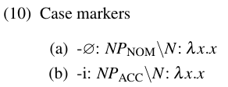
Inflectional Processes
Plural
Case
Relative
T/A/M
Agreement
Voice

Slide 31
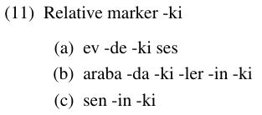
Inflectional Processes
Plural
Case
Relative
T/A/M
Agreement
Voice
Construction?

Slide 32
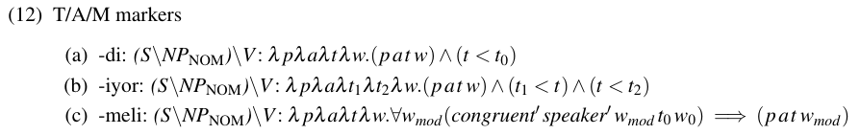
Inflectional Processes
Plural
Case
Relative
T/A/M
Agreement
Voice

Slide 33
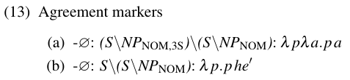
Inflectional Processes
Plural
Case
Relative
T/A/M
Agreement
Voice

Slide 34
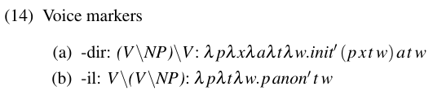
Inflectional Processes
Plural
Case
Relative
T/A/M
Agreement
Voice
Derivation?

Slide 35
Preliminary Work
Deriving from Nouns
Deriving from Verbs
Deriving from Adjectives
Deriving from Adverbs
Inflection vs Derivation
Marking Indefiniteness in Turkish

Slide 36
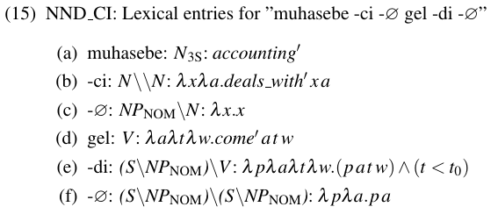
Deriving from Nouns
NND_CI
VND_LAN
JND_LI
AND_CA

Slide 37
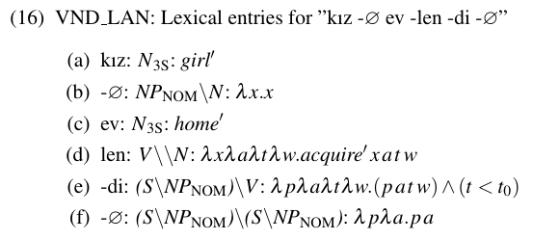
Deriving from Nouns
NND_CI
VND_LAN
JND_LI
AND_CA

Slide 38
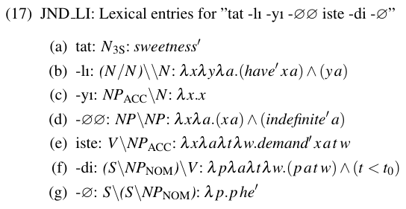
Deriving from Nouns
NND_CI
VND_LAN
JND_LI
AND_CA
ØØ later

Slide 39
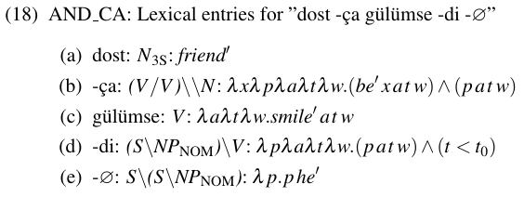
Deriving from Nouns
NND_CI
VND_LAN
JND_LI
AND_CA

Slide 40



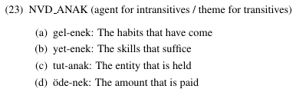
Deriving from Verbs
NVD_ACAK
NVD_AK
NVD_AN
NVD_ANAK
Often depends on the arity of the verb

Slide 41
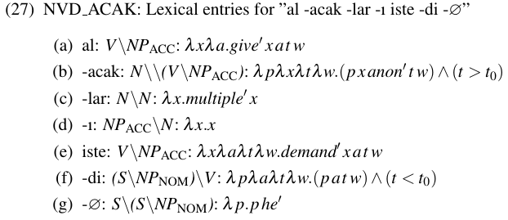
Deriving from Verbs
NVD_ACAK
NVD_AK
NVD_AN
NVD_ANAK
Complex Event Nominals
Aspectual structure present
Derived?
Others
No aspectual structure
Lexicalized?
Grimshaw (1990)

Slide 42





Deriving from Verbs
VVD_AKLA
VVD_ALA
VVD_IKLA
VVD_USTUR
Moens and Steedman (1988)

Slide 43
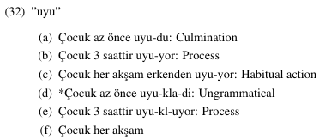
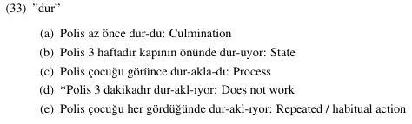
Deriving from Verbs
VVD_AKLA
VVD_ALA
VVD_IKLA
VVD_USTUR

Slide 44
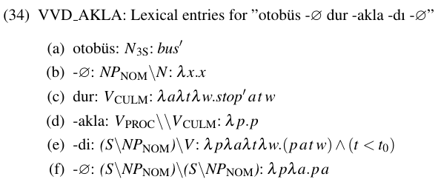
Deriving from Verbs
VVD_AKLA
VVD_ALA
VVD_IKLA
VVD_USTUR

Slide 45
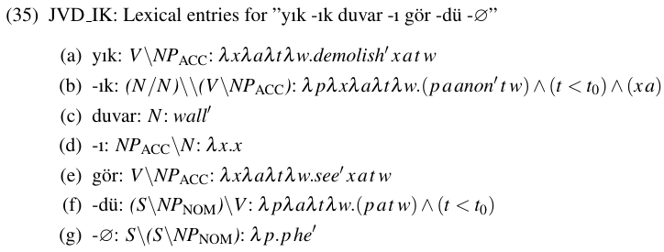
Deriving from Verbs
NVD_ACAK
VVD_AKLA
JVD_IK
AVD_IP

Slide 46
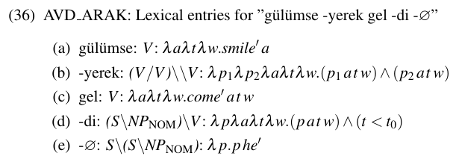
Deriving from Verbs
NVD_ACAK
VVD_AKLA
JVD_IK
AVD_ARAK
AVD_IP
Construction?

Slide 47
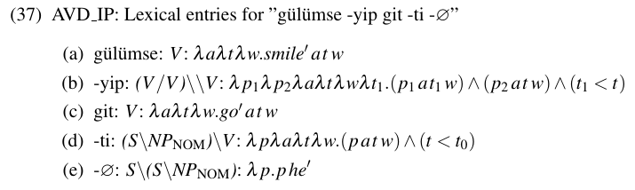
Deriving from Verbs
NVD_ACAK
VVD_AKLA
JVD_IK
AVD_ARAK
AVD_IP
Construction?

Slide 48
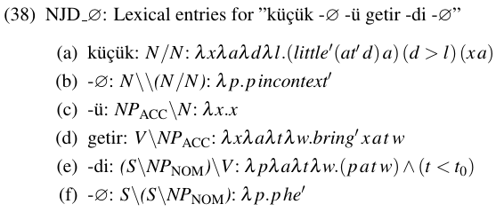
Deriving from Adjectives
NJD_Ø
VJD_LAS
JJD_IMSI
AJD_CA

Slide 49
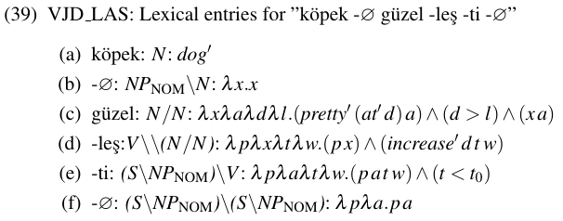
Deriving from Adjectives
NJD_Ø
VJD_LAS
JJD_IMSI
AJD_CA

Slide 50
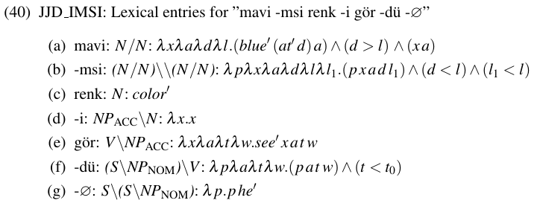
Deriving from Adjectives
NJD_Ø
VJD_LAS
JJD_IMSI
AJD_CA

Slide 51
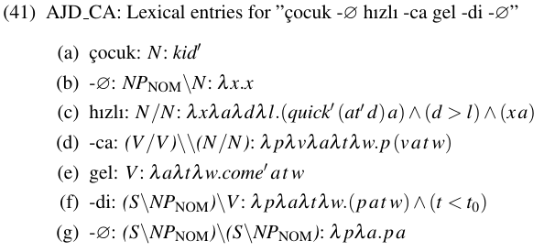
Deriving from Adjectives
NJD_Ø
VJD_LAS
JJD_IMSI
AJD_CA

Slide 52
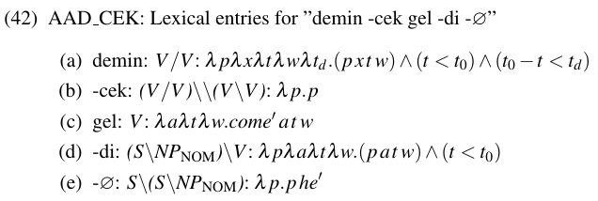
Deriving from Adverbs
AAD_CEK

Slide 53
Preliminary Work
Single slash for inflection and construction
Relative clauses
T/A/M
Agreement
Case
Number
Double slash for derivation
Inflection vs Derivation vs Construction

Slide 54
Preliminary Work
Definiteness and Referentiality in Turkish
Verbal Sentences (Dede, 1986)
Non-Verbal Sentences (Tura, 1986)
Marking Indefiniteness in Turkish

Slide 55
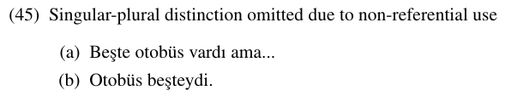
Marking Indefiniteness in Turkish
Neutralizing the singular-plural distinction due to non-referentiality
Tura (1986)

Slide 56
Marking Indefiniteness in Turkish
Two dimensions of indefiniteness

Slide 57
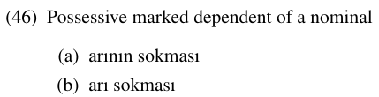
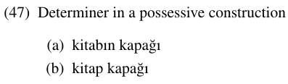
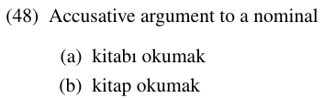
Marking Indefiniteness in Turkish
Generally accepted variations due to indefiniteness

Slide 58
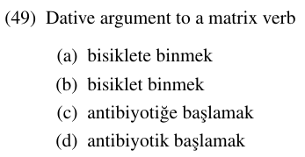
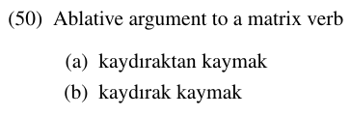
Marking Indefiniteness in Turkish
Some other variations due to indefiniteness

Slide 59
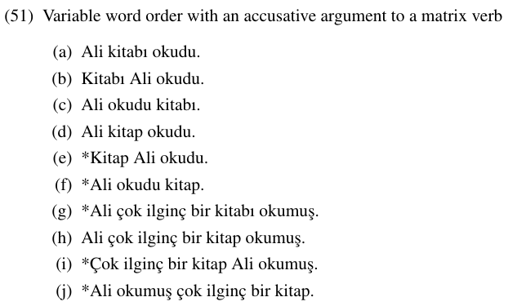
Marking Indefiniteness in Turkish
Case marking is mandatory with non-standard word order

Slide 60

Marking Indefiniteness in Turkish
A possible counterexample

Slide 61
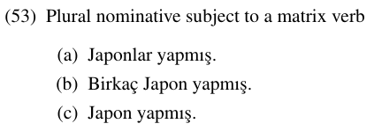
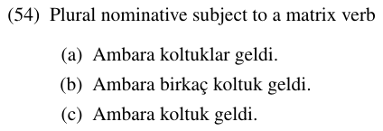
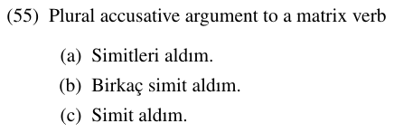
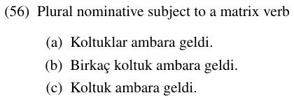
Marking Indefiniteness in Turkish
Omission of plural markers

Slide 62
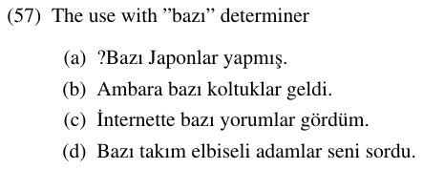
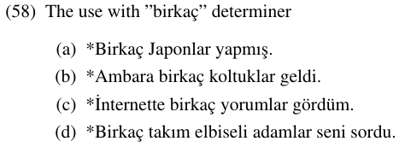
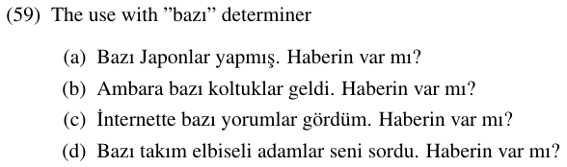
Marking Indefiniteness in Turkish
Bazı makes the NP indefinite, specific.
Birkaç makes the NP indefinite, non-specific?
Bliss (2004)

Slide 63
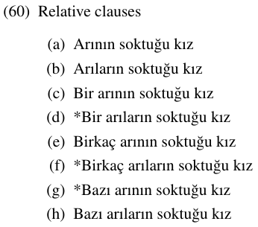
Marking Indefiniteness in Turkish
Genitive marker on relative clause subjects?
George and Kornfilt (1981)

Slide 64
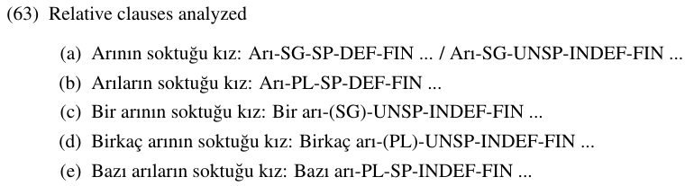
Marking Indefiniteness in Turkish
Morphological analysis of some examples
Sequence of NNI affixes

Slide 65
References
M. Aronoff. Morphology by itself: Stems and inflectional classes. MIT press, 1994.
M. Aronoff and K. Fudeman. What is morphology? Oxford: Blackwell Publishing, 2005.
M. Baker. Incorporation: A Theory of Grammatical Function Changing. Chicago University Press, 1988.
H. Bliss. The semantics of the bare noun in turkish. In I. Mezhevich and M. B. Dobrovolsky, editors, Calgary Papers in Linguistics, volume 25, pages 1–65. University of Calgary, 2004.
C. Bozşahin. The combinatory morphemic lexicon. Computational Linguistics, 28(2):145–186, 2002.
C. Bozşahin. CCGlab Manual, 2017. URL http://bozsahin.github.io/ccglab.
C. Bozşahin. Some binary concepts in turkish morphology. Cem Bozşahin, 2018.
A. Carstairs-McCarthy. The evolution of morphology. Oxford University Press, 2010.

Slide 66
References
E. A. Cowper. A concise introduction to syntactic theory : the government-binding approach. University of Chicago Press, 1992.
M. Dede. Definiteness and referentiality in turkish verbal sentences. In D. I. Slobin and K. Zimmer, editors, Studies in Turkish Linguistics, pages 147–164. John Benjamins, 1986. URL https://www.jbe-platform.com/content/books/9789027279163-09ded.
D. Dowty. The Scope of Lexical Rules, chapter Quantification and the Lexicon, pages 79–106. Foris, Dordrecht, 1981.
E. Erguvanlı-Taylan, editor. The Verb in Turkish. Amsterdam: John Benjamins, 2001.
L. George and J. Kornfilt. Binding and Filtering, chapter Finiteness and Boundedness in Turkish, pages 104–127. London: Croom Helm; Cambridge, Mass: MIT, 1981.
A. Göksel and C. Kerslake. Turkish : a comprehensive grammar. London: Routledge, 2005.
J. Grimshaw. Argument Structure. MIT Press, 1990.
K. Hale and S. J. Keyser. Prolegomenon to a Theory of Argument Structure. MIT Press, 2002.

Slide 67
References
C. Kennedy. Vagueness and grammar: the semantics of relative and absolute gradable adjectives. Linguistics and Philosophy, 30:1–45, 2007.
C. Kennedy and L. McNally. Scale structure, degree modification, and the semantics of gradable predicates. Linguistic Society of America, 81(2):345–381, 2005.
O. Kılıc¸ and C. Bozşahin. Selection of linker type in emphatic reduplication: Speaker’s intuition meets corpus statistics. In 35th Annual Meeting of Cognitive Science Society, volume 35, 2013.
R. Lieber. Deconstructing morphology: word formation in syntactic theory. University of Chicago Press, 1992.
M. Moens and M. Steedman. Temporal ontology and temporal reference. Computational Linguistics, 14:15–28, 1988.
K. Oflazer, E. Göçmen, and C. Bozşahin. An outline of turkish morphology. Technical report, Middle East Technical University and Bilkent University, 1995. Re-issued in 2014.
U. Ozge. Personal communication, 2019.
F. Paoli. Comparative logic as an approach to comparison in natural language. Journal of Semantics, 16:67–96, 1999.

Slide 68
References
C. Paradis. Adjectives and boundedness. Cognitive Linguistics, 12(1):47–65, 2001.
F. E. Sezer. Issues in Turkish Syntax. PhD thesis, Harvard University, 1991.
M. Steedman and J. Baldridge. Non-Transformational Syntax, chapter Combinatory Categorial Grammar, pages 181–224. Blackwell, 2011.
M. Steedman and C. Bozşahin. Projecting from the lexicon. Mark Steedman and Cem Bozşahin, n.d.
S. S. Tura. Definiteness and referentiality in turkish nonverbal sentences. In D. I. Slobin and
K. Zimmer, editors, Studies in Turkish Linguistics, pages 165–194. John Benjamins, 1986. URL https://www.jbe-platform.com/content/books/9789027279163-09ded.
R. D. Van-Valin Jr. Linguistic Universals, chapter Some Universals of Verb Semantics, pages 155–178. Cambridge University Press, 2006.
A. Wedel. Turkish emphatic reduplication. Technical report, UC Santa Cruz: Working Papers, 1999.

